Slide 1
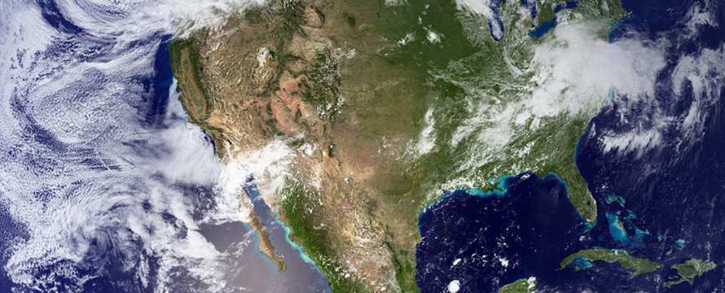

NASA Next Gen STEM Resources
GOES U/NOAA EDUCATOR WORKSHOP KENNEDY SPACE CENTER
^{June 25, 2024}

Slide 2
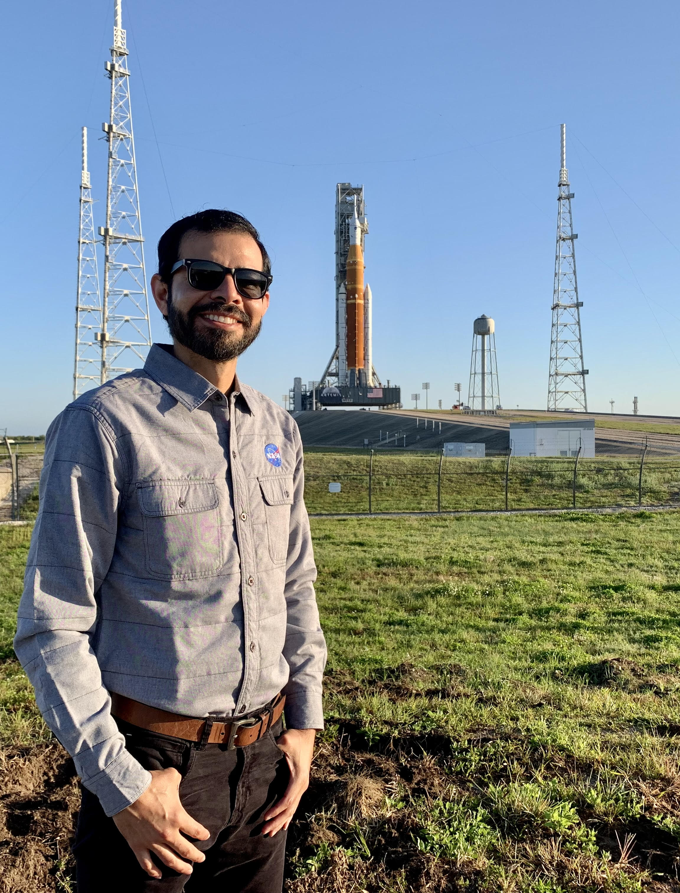


About Me
Project Coordinator
Samuel Garcia Jr., Ph.D.
NSTEM
hq-epd@mail.nasa.gov
Dr. Samuel Garcia is a dedicated educator with over 15 years of experience in various capacities within the field of education. Committed to supporting both educators and students, Dr. Garcia works to create rich learning experiences and innovative products designed to enhance STEM learning and foster a strong sense of STEM identity. Dr. Garcia worked at NASA's Jet Propulsion Laboratory (JPL) before transitioning to the Kennedy Space Center in Cape Canaveral, FL.
Dr. Garcia holds both a bachelor's and a master's degree from the University of Texas Rio Grande Valley and a doctorate degree from Texas State University. With a passion for education and a commitment to advancing STEM, Dr. Garcia continues to inspire and impact the next generation of learners and educators.

Slide 3
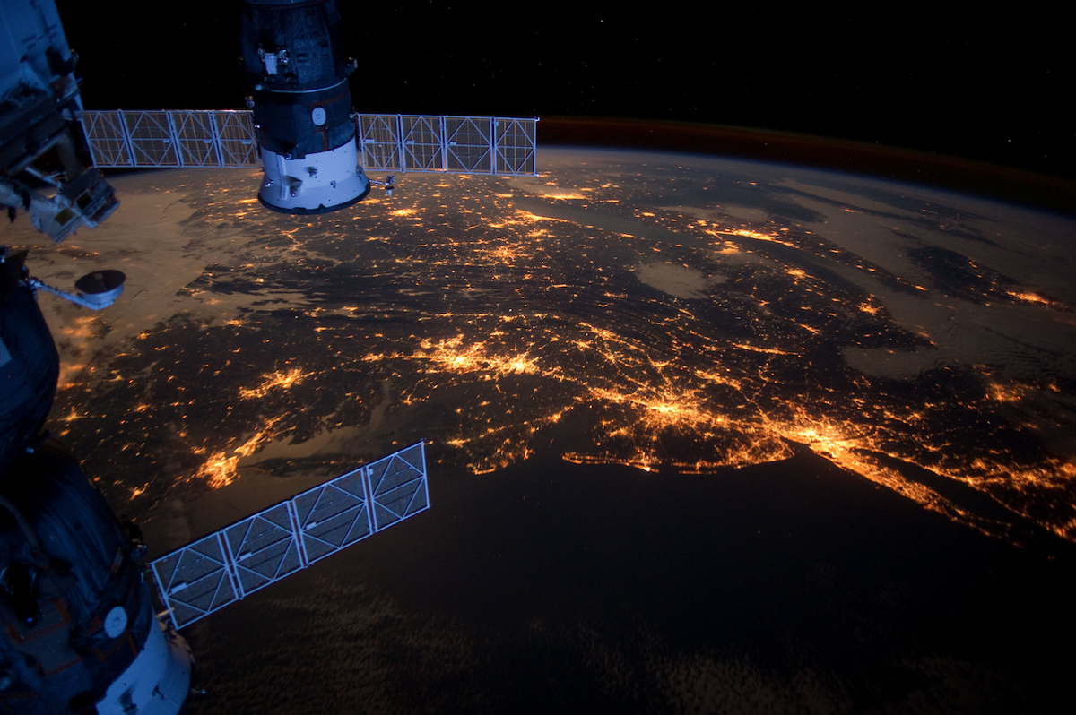
Agenda
NASA STEM Engagement
Next Gen STEM (NGS)
NASA Resources for Educators
NASA Resources: How to Stay Connected
STEM Gateway CONNECTS Registration
Notes:
Will wait until presentation is fully like we want it and then can fill out.
Script: Please see our agenda for today. We will discuss:

Slide 4
NASA STEM

Slide 5
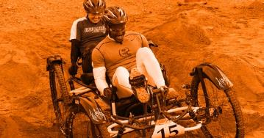


Office of STEM Engagement Overview
VISION
We immerse students in NASA’s work, enhance STEM literacy, and inspire the next generation to explore.
MISSION
We engage students in NASA’s mission
Strategic Goals
Create unique opportunities for a diverse set of students to contribute to NASA’s work in exploration and discovery.
Build a diverse future STEM workforce by engaging students in authentic learning experiences with NASA’s people, content and facilities.
Attract diverse groups of students to STEM through learning opportunities that spark interest and provide connections to NASA’s mission and work.
Notes:
Updated as of 5/1/2024

Slide 6
Dear Ms. Venecia,
I hope this message finds you well.
I am pleased to inform you that I have created a flyer for the upcoming Earth and Space Celebration. I would appreciate your review and approval of the design.
Thank you very much to you and your team for providing the venue to host this event. Your support is greatly appreciated.
Looking forward to your feedback.
Best regards,
Next Gen STEM

Slide 7
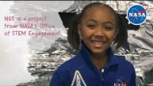
What is Next Gen STEM?
Notes:
NGS Overview Video: (2:34)
https://youtu.be/tQkqa0FWydE.

Slide 8
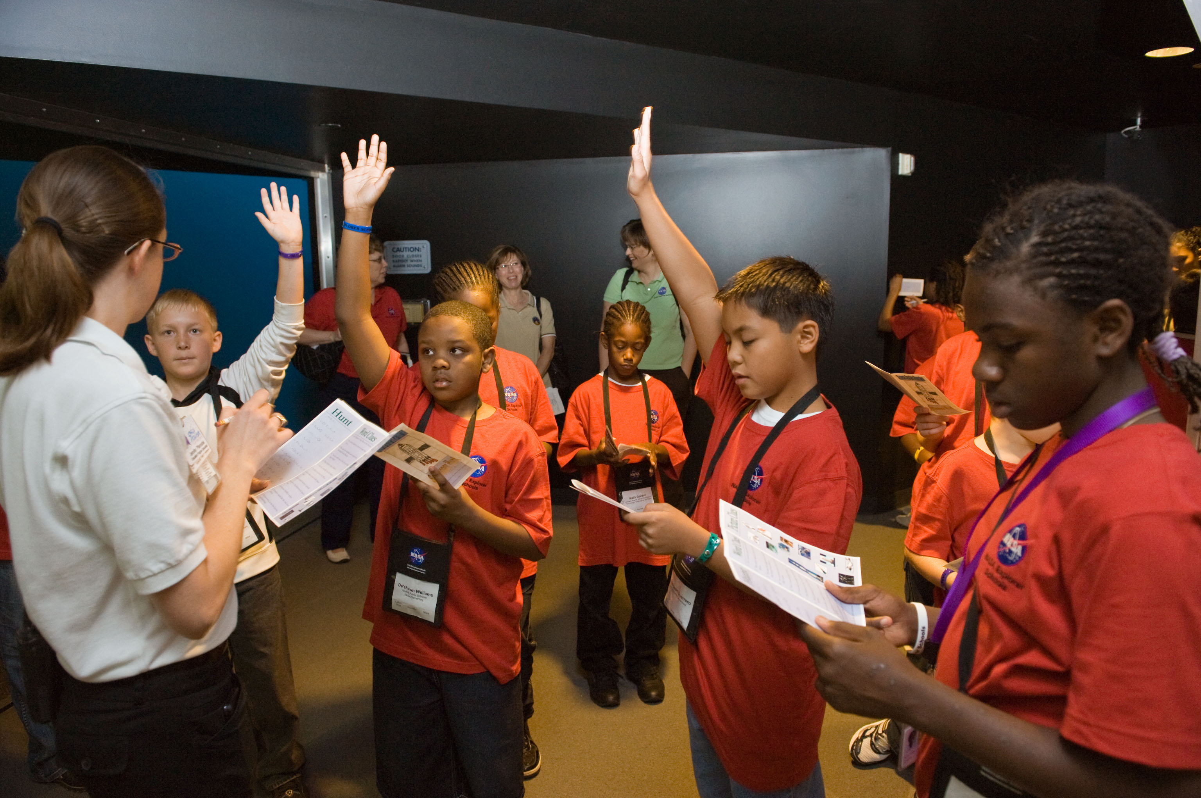
STEM at NASA
Students
Internships and Fellowships
Student learning opportunities and activities (challenges, competitions, and other experiences)
Informal education and out-of-school learning activities
Educators
Educational products, tools, and platforms
Educator professional development
Competitive awards to educational institutions
Notes:
Script: The scope of STEM Engagement comprises all endeavors to attract, engage, and educate students and to support educators and educational institutions. The STEM engagement portfolio consists of a diverse set of opportunities, activities and products, encompassing internships; fellowships; student learning opportunities (challenges, competitions and other experiences); informal education and out-of-school learning activities; educational products, tools, and platforms; educator support; competitive awards to educational institutions for research and development and institutional support.

Slide 9
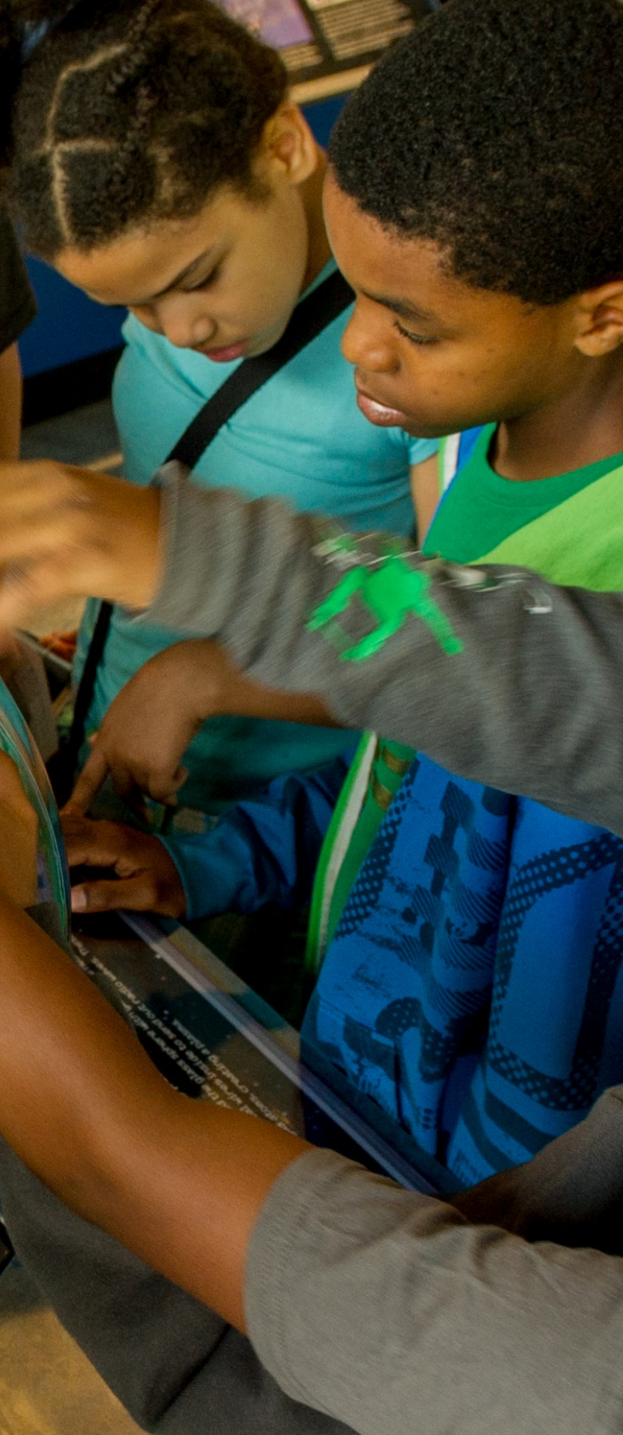




Moon – Lessons and activities to engage students in NASA’s Artemis missions to the Moon while inspiring them to become part of the Artemis Generation.
Solar System & Beyond – Engaging hands-on student activities and educator resources geared towards learning more about how NASA is uncovering new worlds, stars, and cosmic mysteries near and far with a diverse set of space and ground-based missions.
NEXT GEN STEM
Aeronaut-X – Activities focused on cutting-edge aeronautics content to encourage future aviation explorers to take a deep dive into the world of a new generation of flight.
Earth – Resources to help students learn about Earth and climate science missions, connect with the International Space Station and its crew, and learn new ways to contribute to NASA’s Missions.

Slide 10
NASA STEM Resources

Slide 11
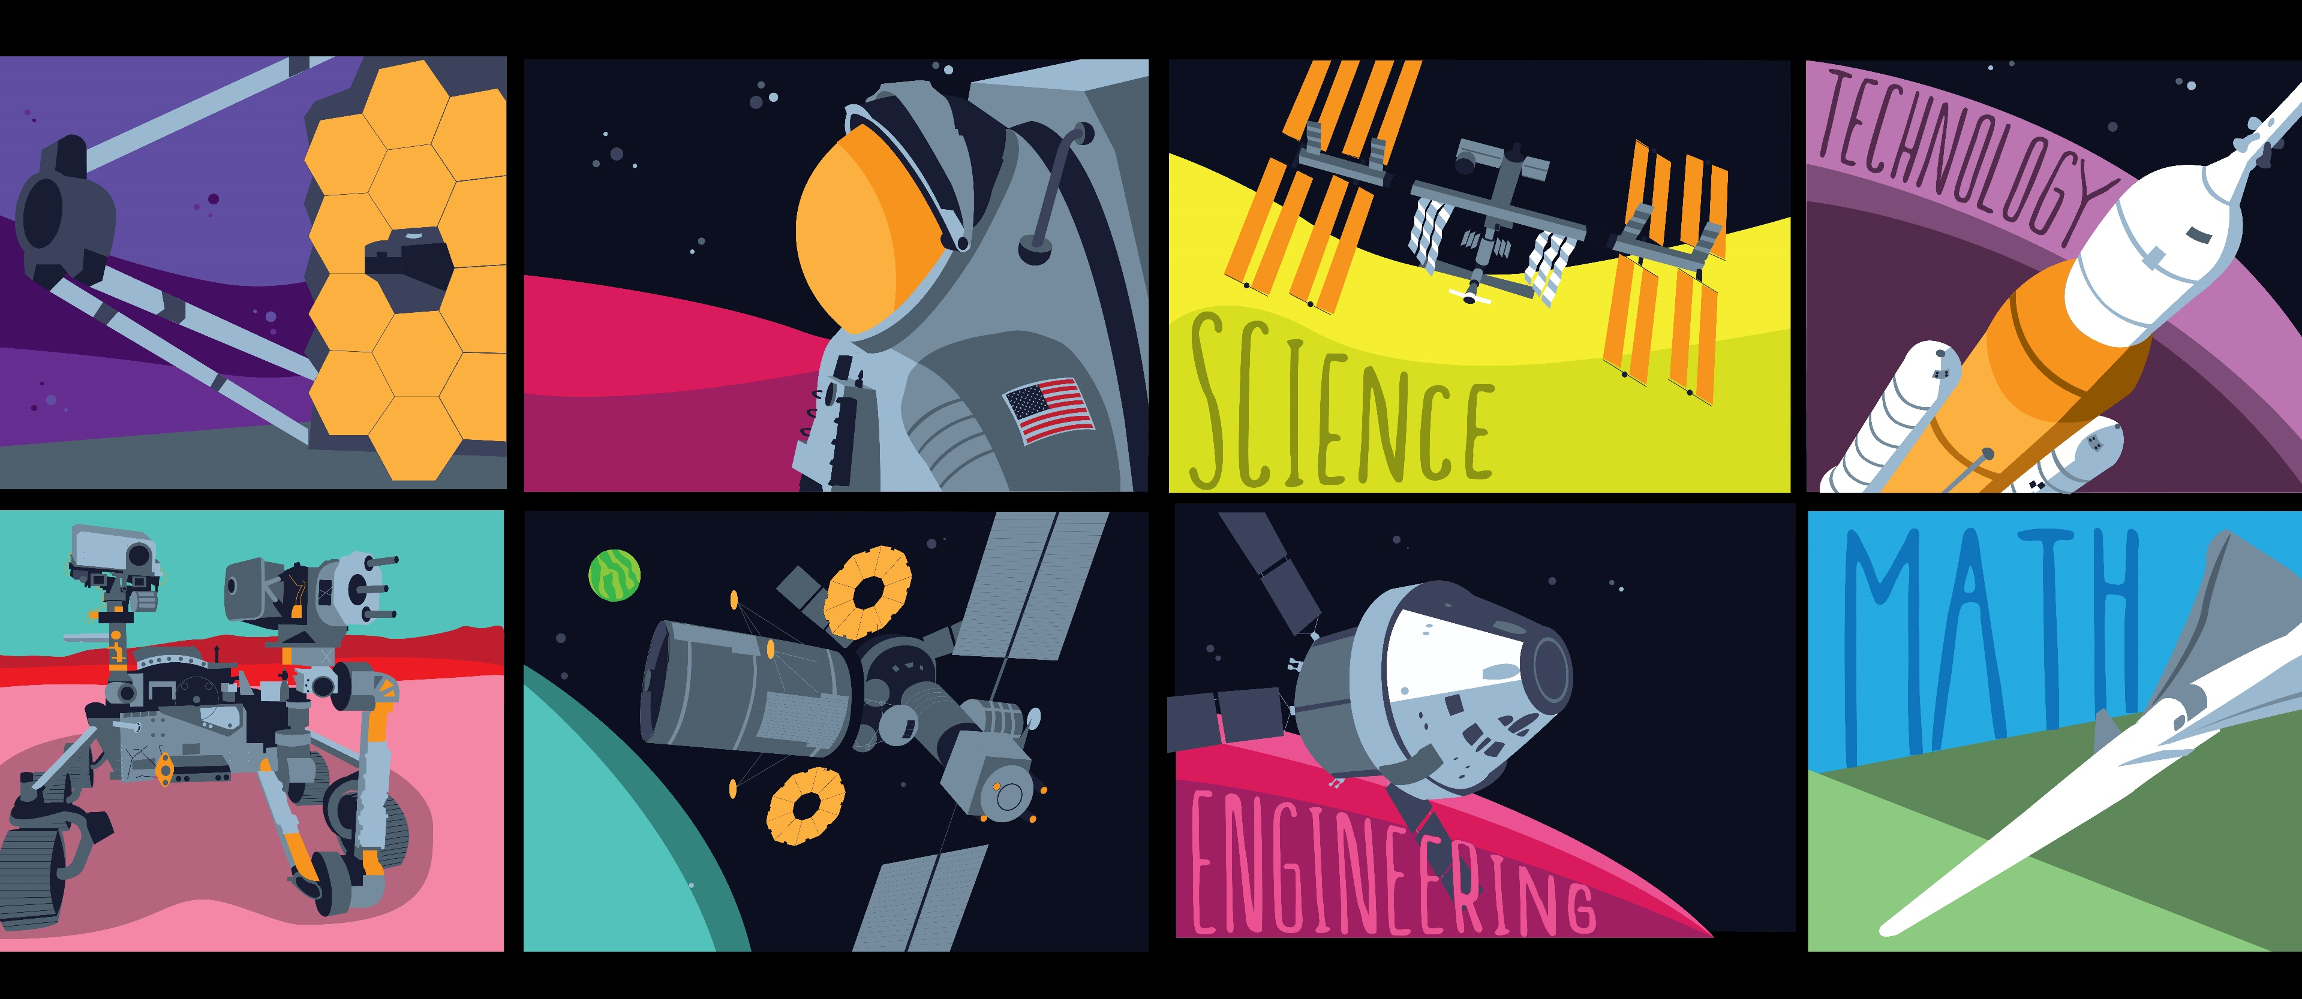
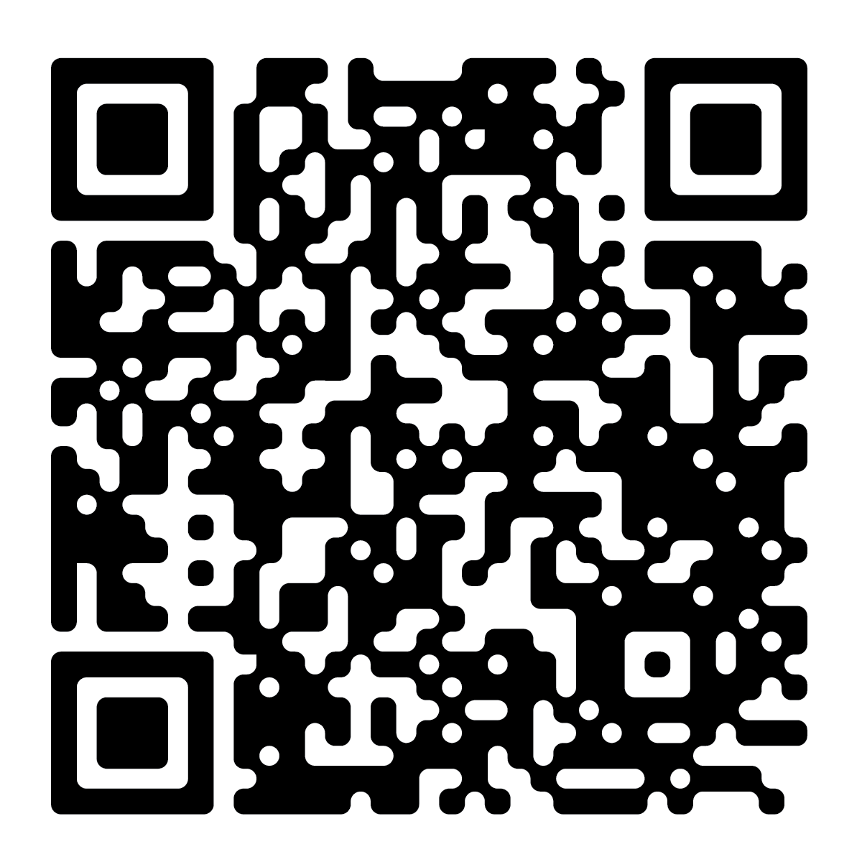
For Kids and Students
Space to Play
Grades K-4
Experience NASA
Grades 9-12
https://go.nasa.gov/3TEC06l
https://go.nasa.gov/4czswlo
Out-of-This-World Stuff!
Grades 5-8
Explore Opportunities
College Students
https://go.nasa.gov/4aiDoTj
https://go.nasa.gov/3TziTKX
Notes:
Updated as of 5/1/2024

Slide 12
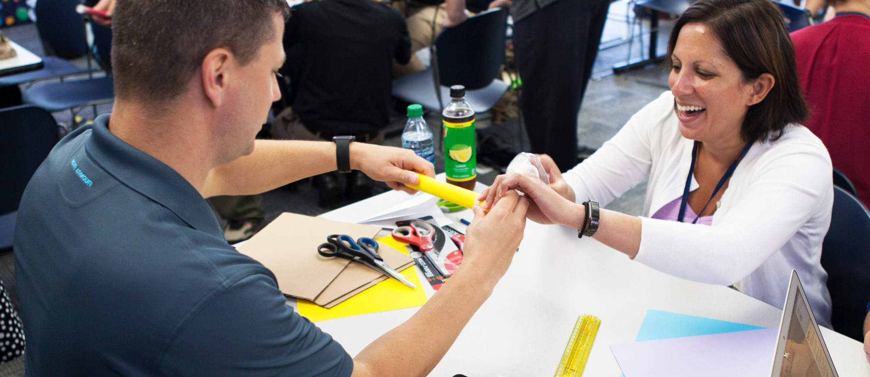
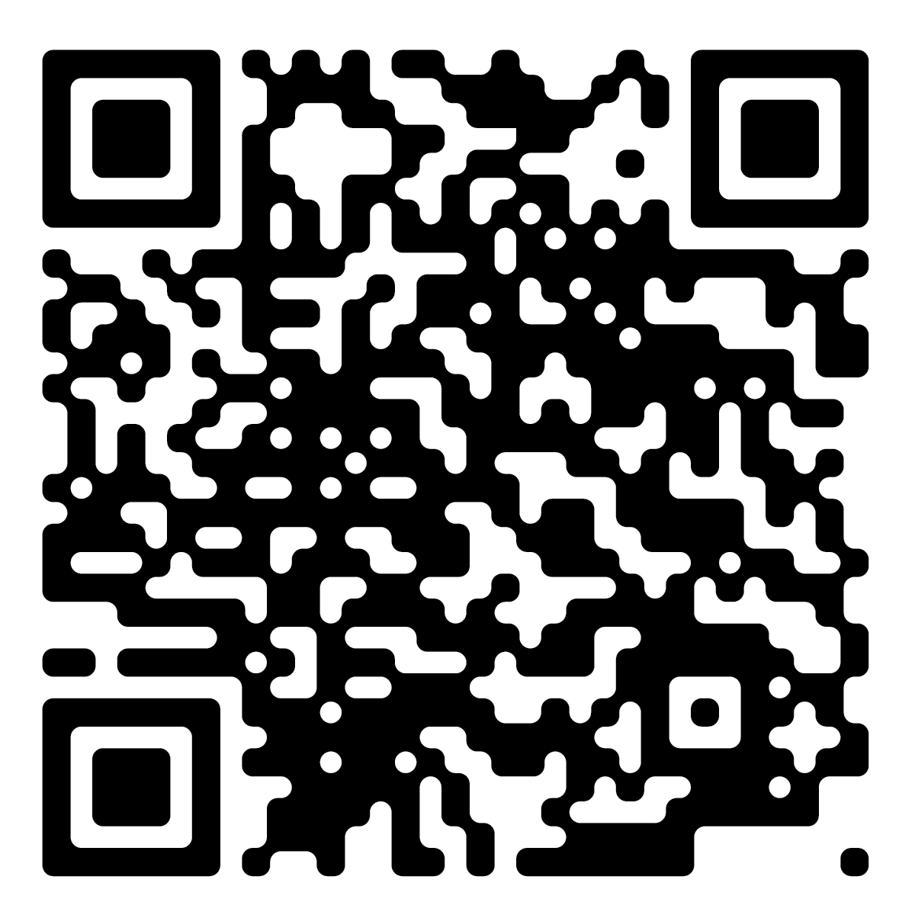
Next Gen STEM for Educators
Next Gen STEM For Educators
Find Next Gen STEM learning opportunities for students in multiple settings – in school, afterschool programs informal institutions like museums and science centers, and at home.
https://go.nasa.gov/4cWxB7R
Notes:
Updated as of 5/1/2024

Slide 13
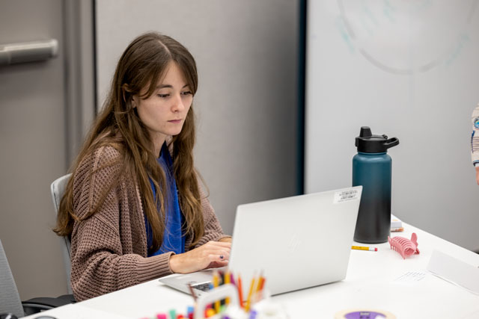
Educator Professional Development (EPD) Online Options
Partner Webinars
Online sessions for teachers providing professional learning opportunities via an online platform.
    NASA STEM 101 for Educators webinar – introduction to all things NASA Next Gen STEM (NGS).
    Spanish language webinars – NGS mission focused area webinars presented in Spanish on a quarterly basis.
    Requested webinars – NASA STEM requests submitted via hq-epd@nasa.gov.
Notes:
https://astronautappearances.nasa.gov/
Script: The EPD team provides virtual educator professional learning opportunities (though weekly webinars, virtual workshops, and badging (which is not accessible yet, but coming)) and in-person learning opportunities (through lectures and speaking engagements, workshops, and conferences). By joining the NASA CONNECTs platform, you will be notified of all events the EPD team is hosting (virtual and in-person). You can also request an EPD session for your educators through a request process as well. For more information you can contact the EPD team at hq-epd@mail.nasa.gov.

Slide 14
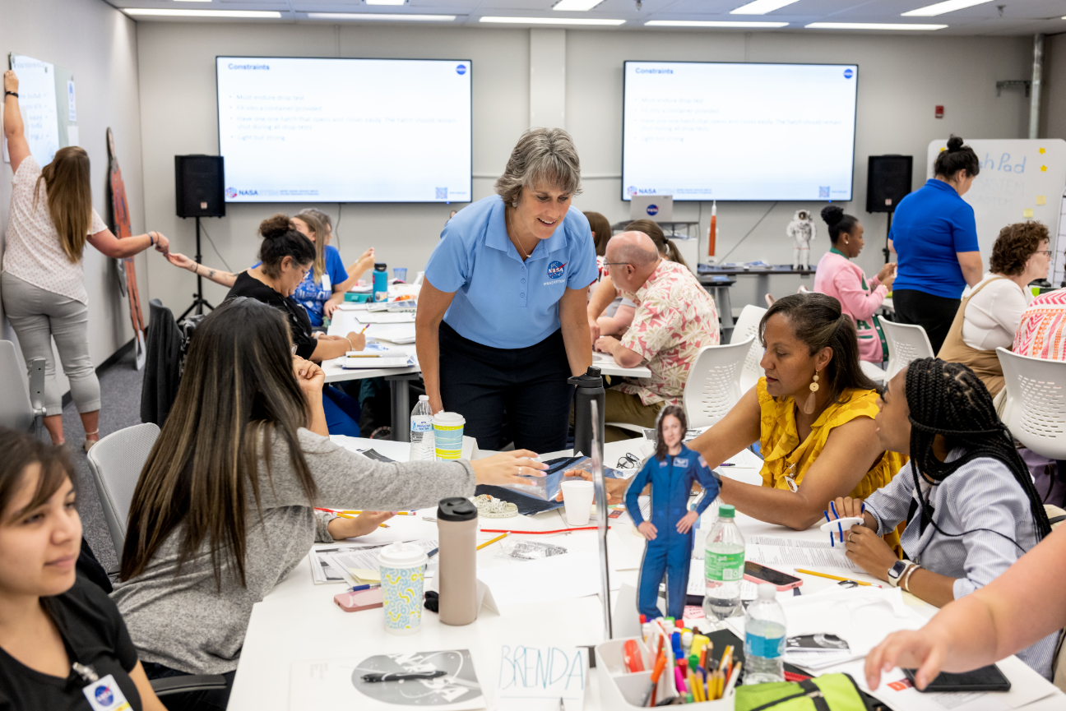
EPD In-Person Options
Workshops
Provides active learning such as a hands-on activity or engagement that can range from a few hours to multiple days.
Conferences
EPD proposes sessions or is requested to present on Next Gen STEM and mission-focused materials at targeted conferences (i.e., NSTA, NCTM, ITEEA, SEEC).
Next Gen STEM 101 Workshop
A multi-day professional learning opportunity that is an immersive hands-on experience for educators.
External Requests
Can be an external request that provides PD but there is no hands-on activity or engagement.
*All selections must go through the request process*
Notes:
https://astronautappearances.nasa.gov/
Script: The EPD team provides virtual educator professional learning opportunities (though weekly webinars, virtual workshops, and badging (which is not accessible yet, but coming)) and in-person learning opportunities (through lectures and speaking engagements, workshops, and conferences). By joining the NASA CONNECTs platform, you will be notified of all events the EPD team is hosting (virtual and in-person). You can also request an EPD session for your educators through a request process as well. For more information you can contact the EPD team at hq-epd@mail.nasa.gov.

Slide 15
NASA STEM Challenges

Slide 16

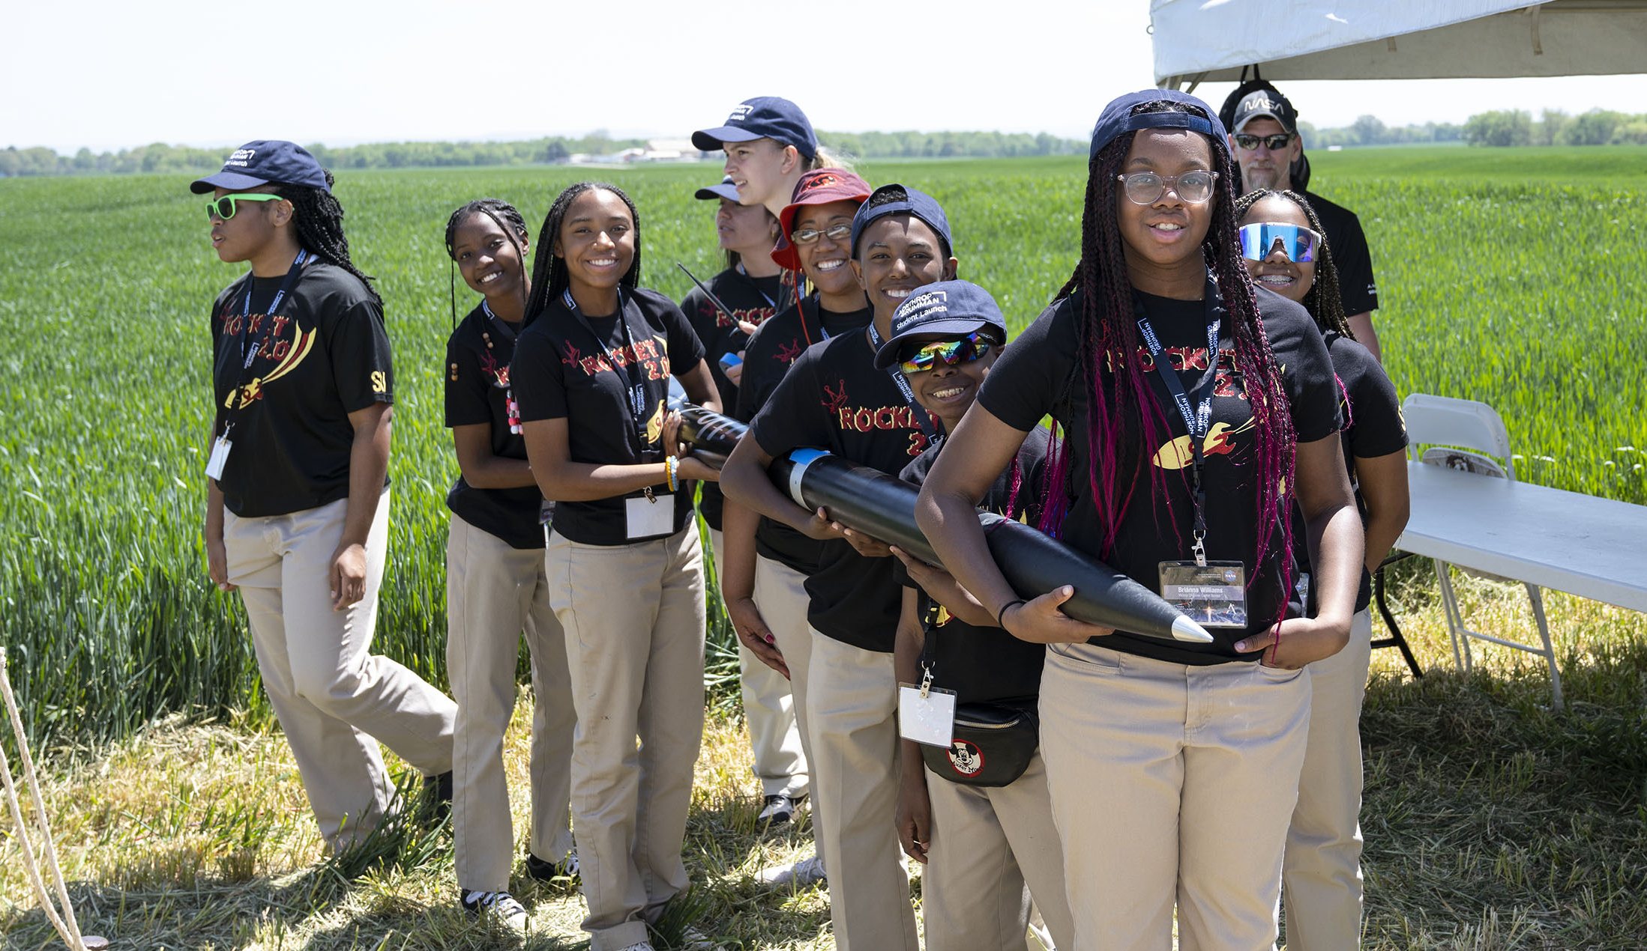
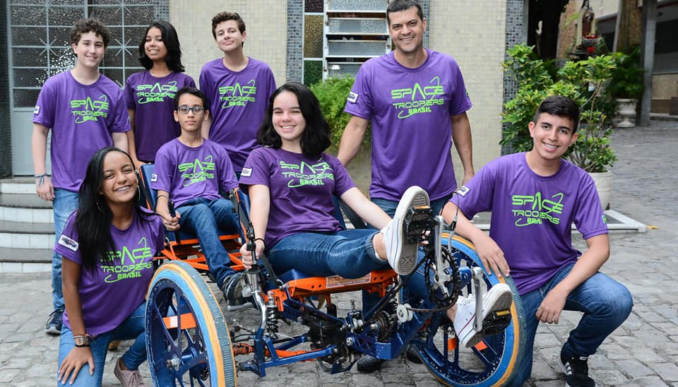
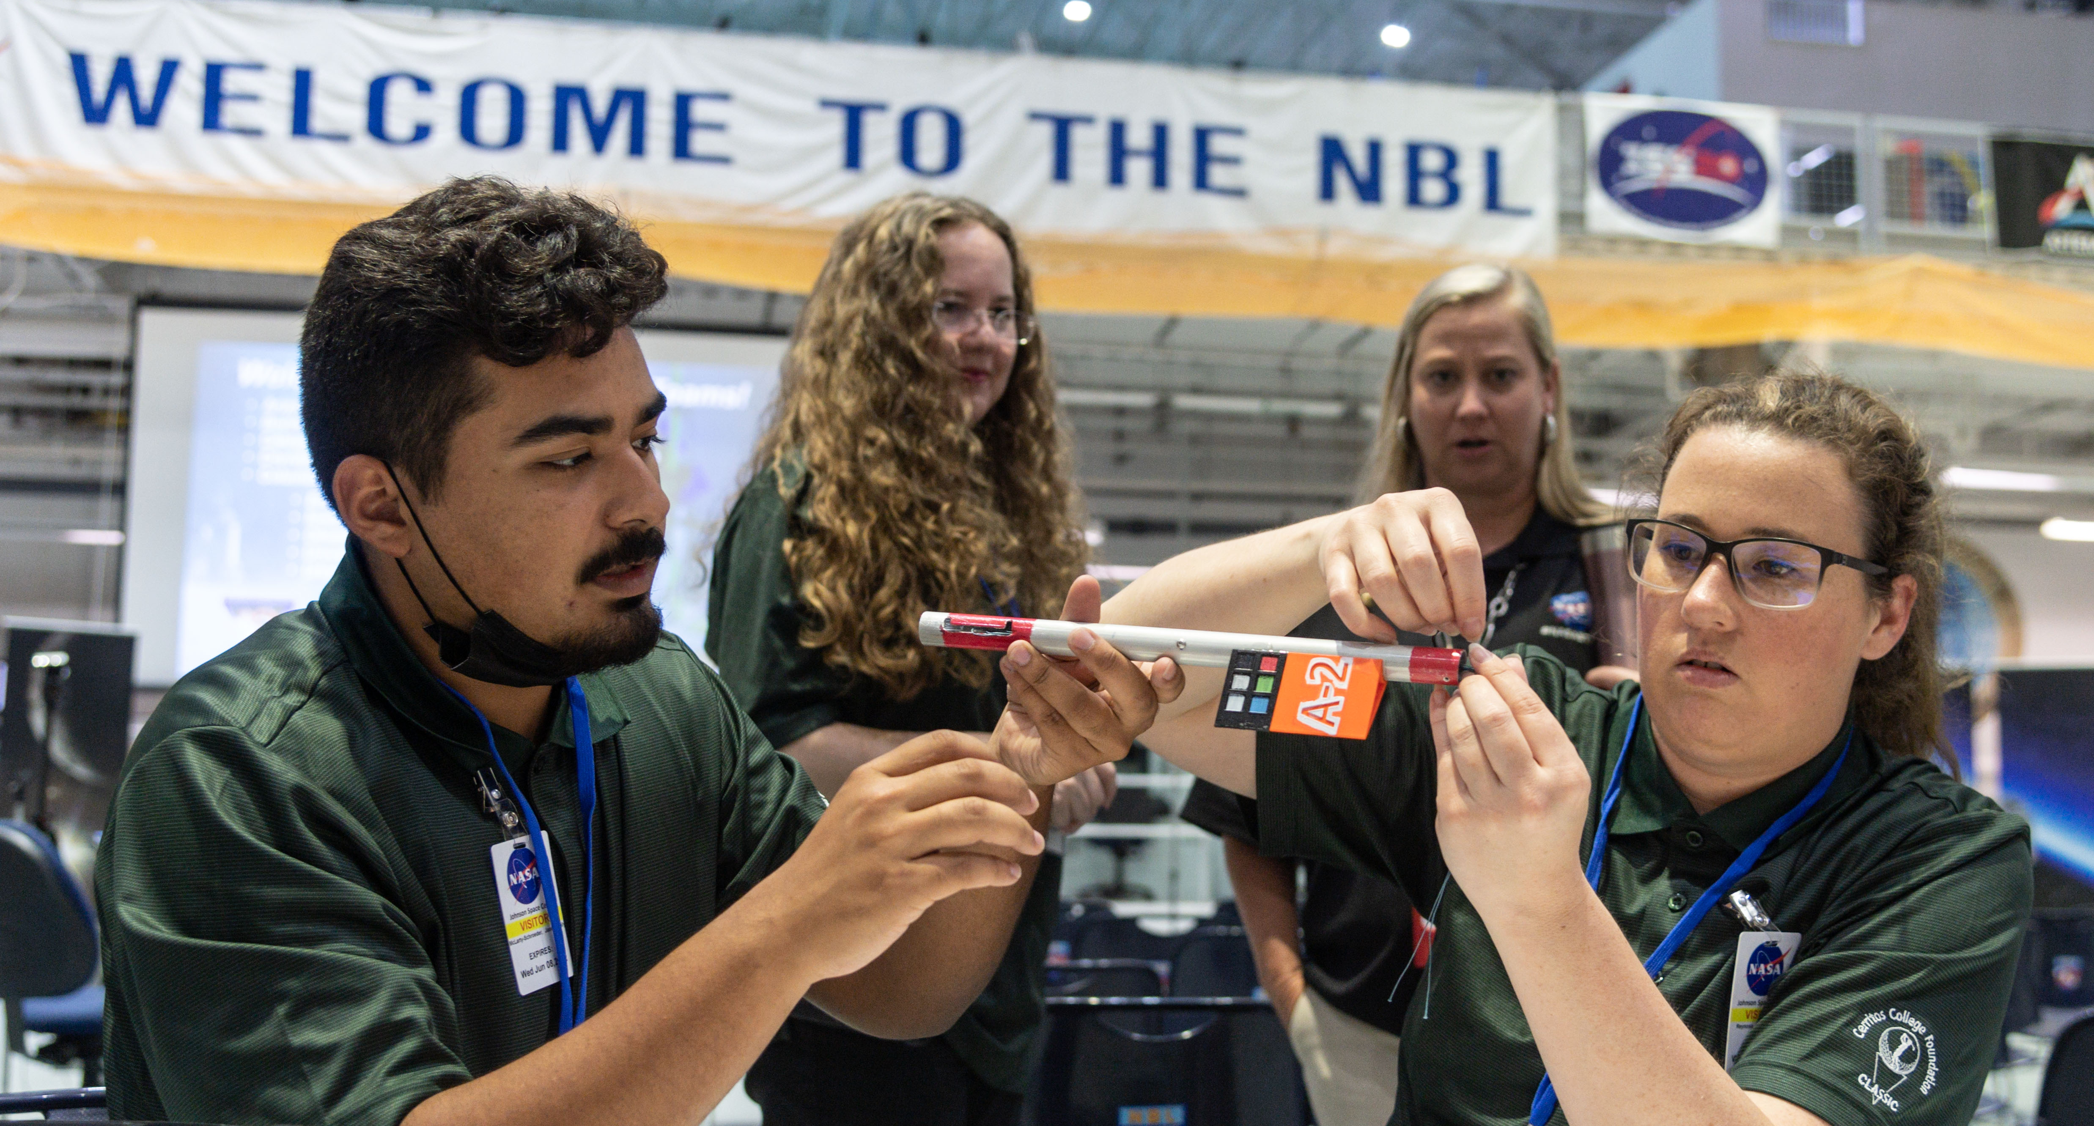
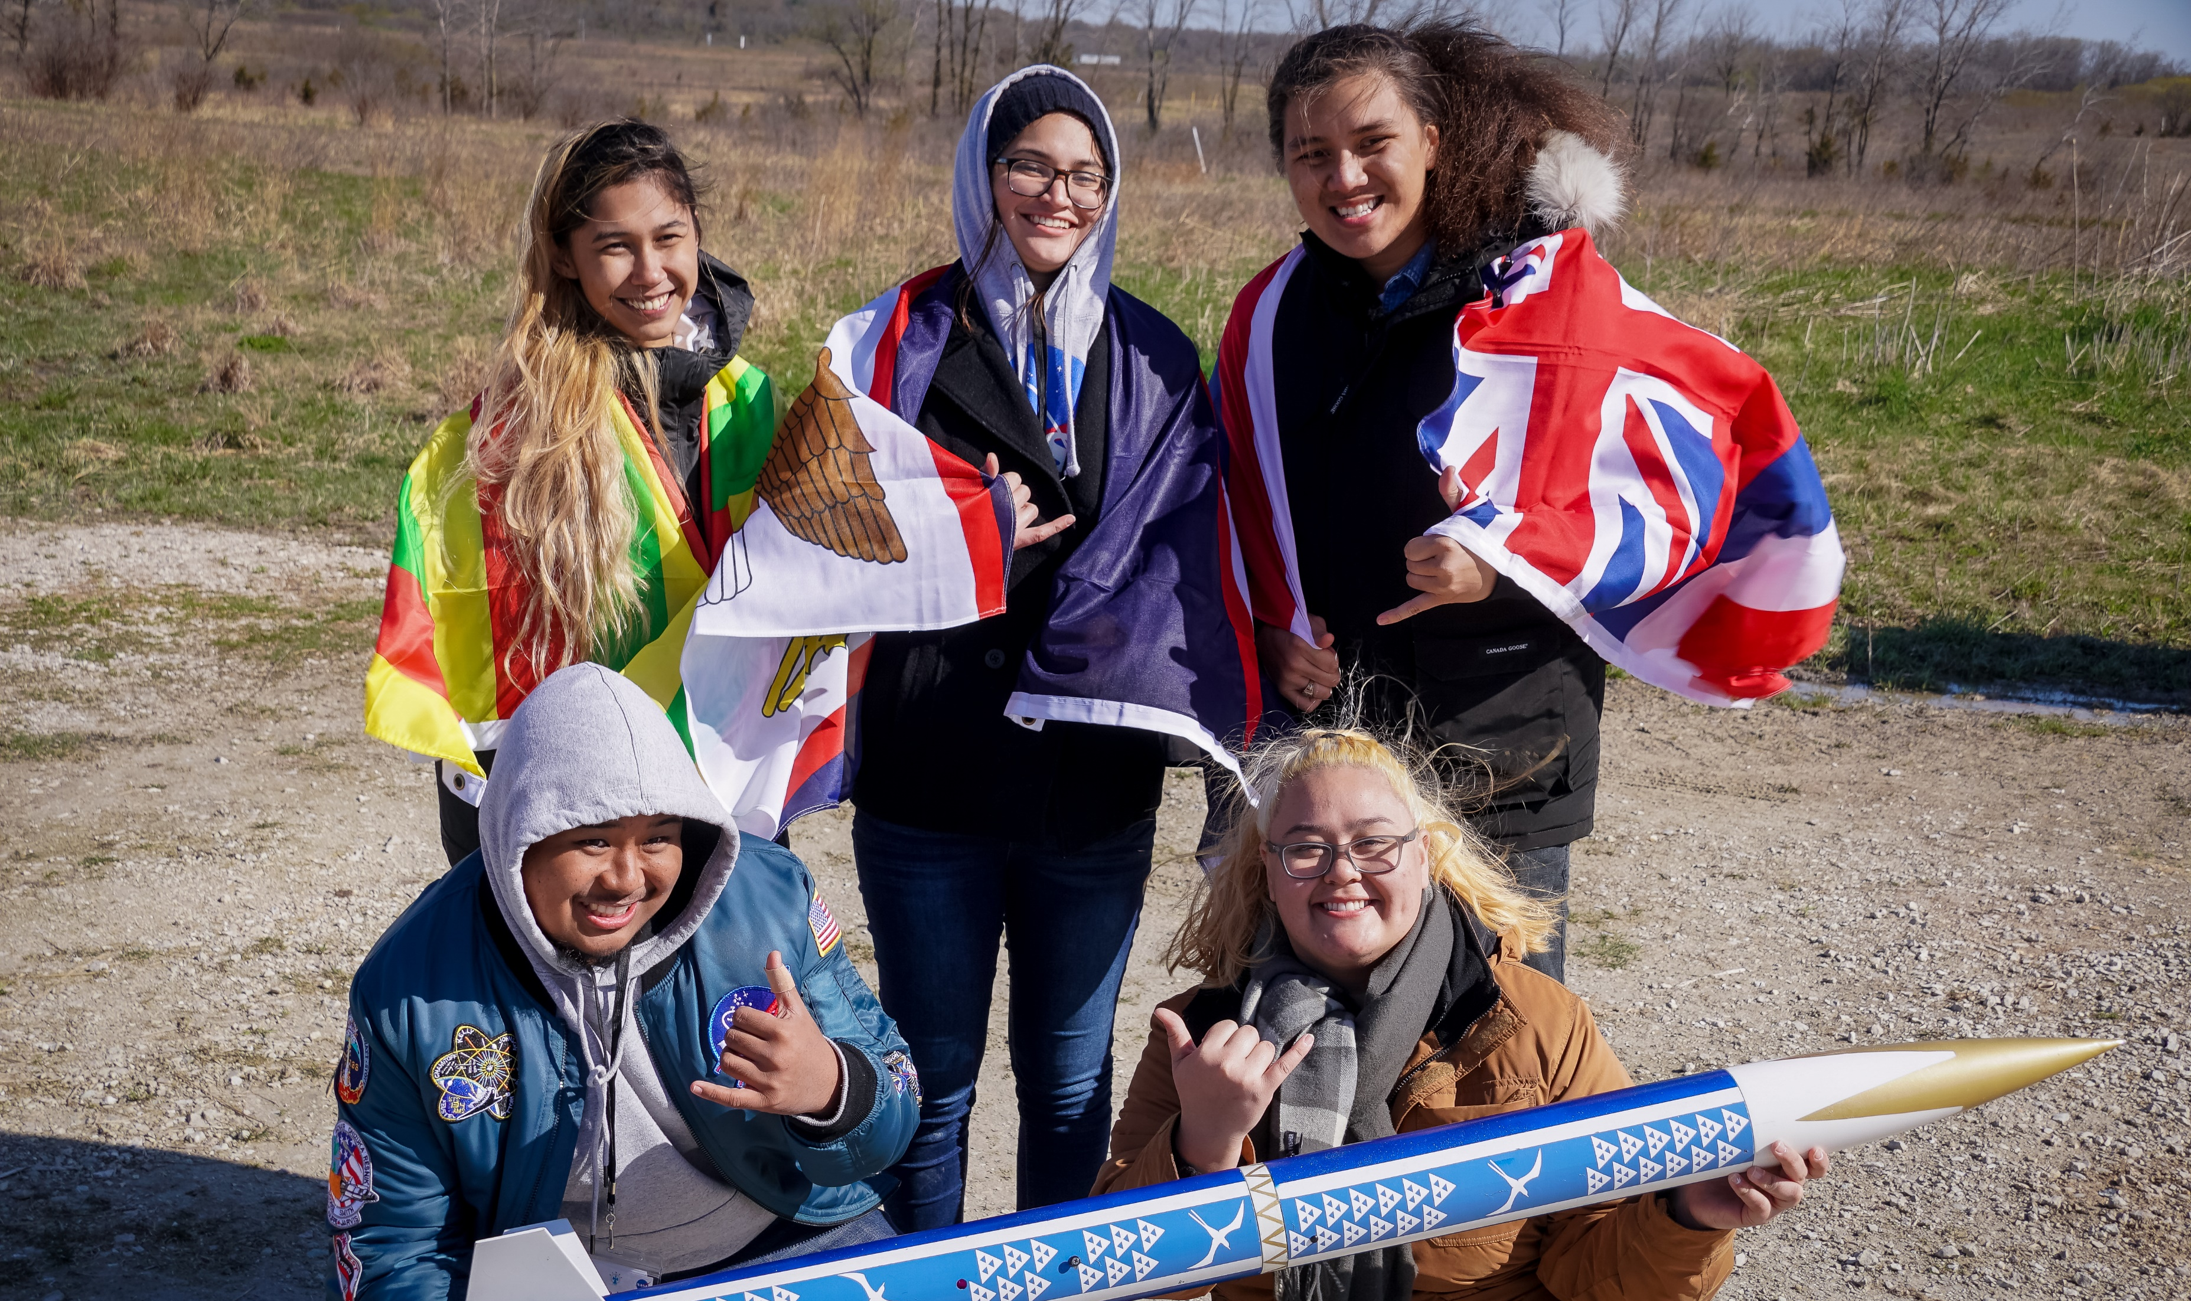
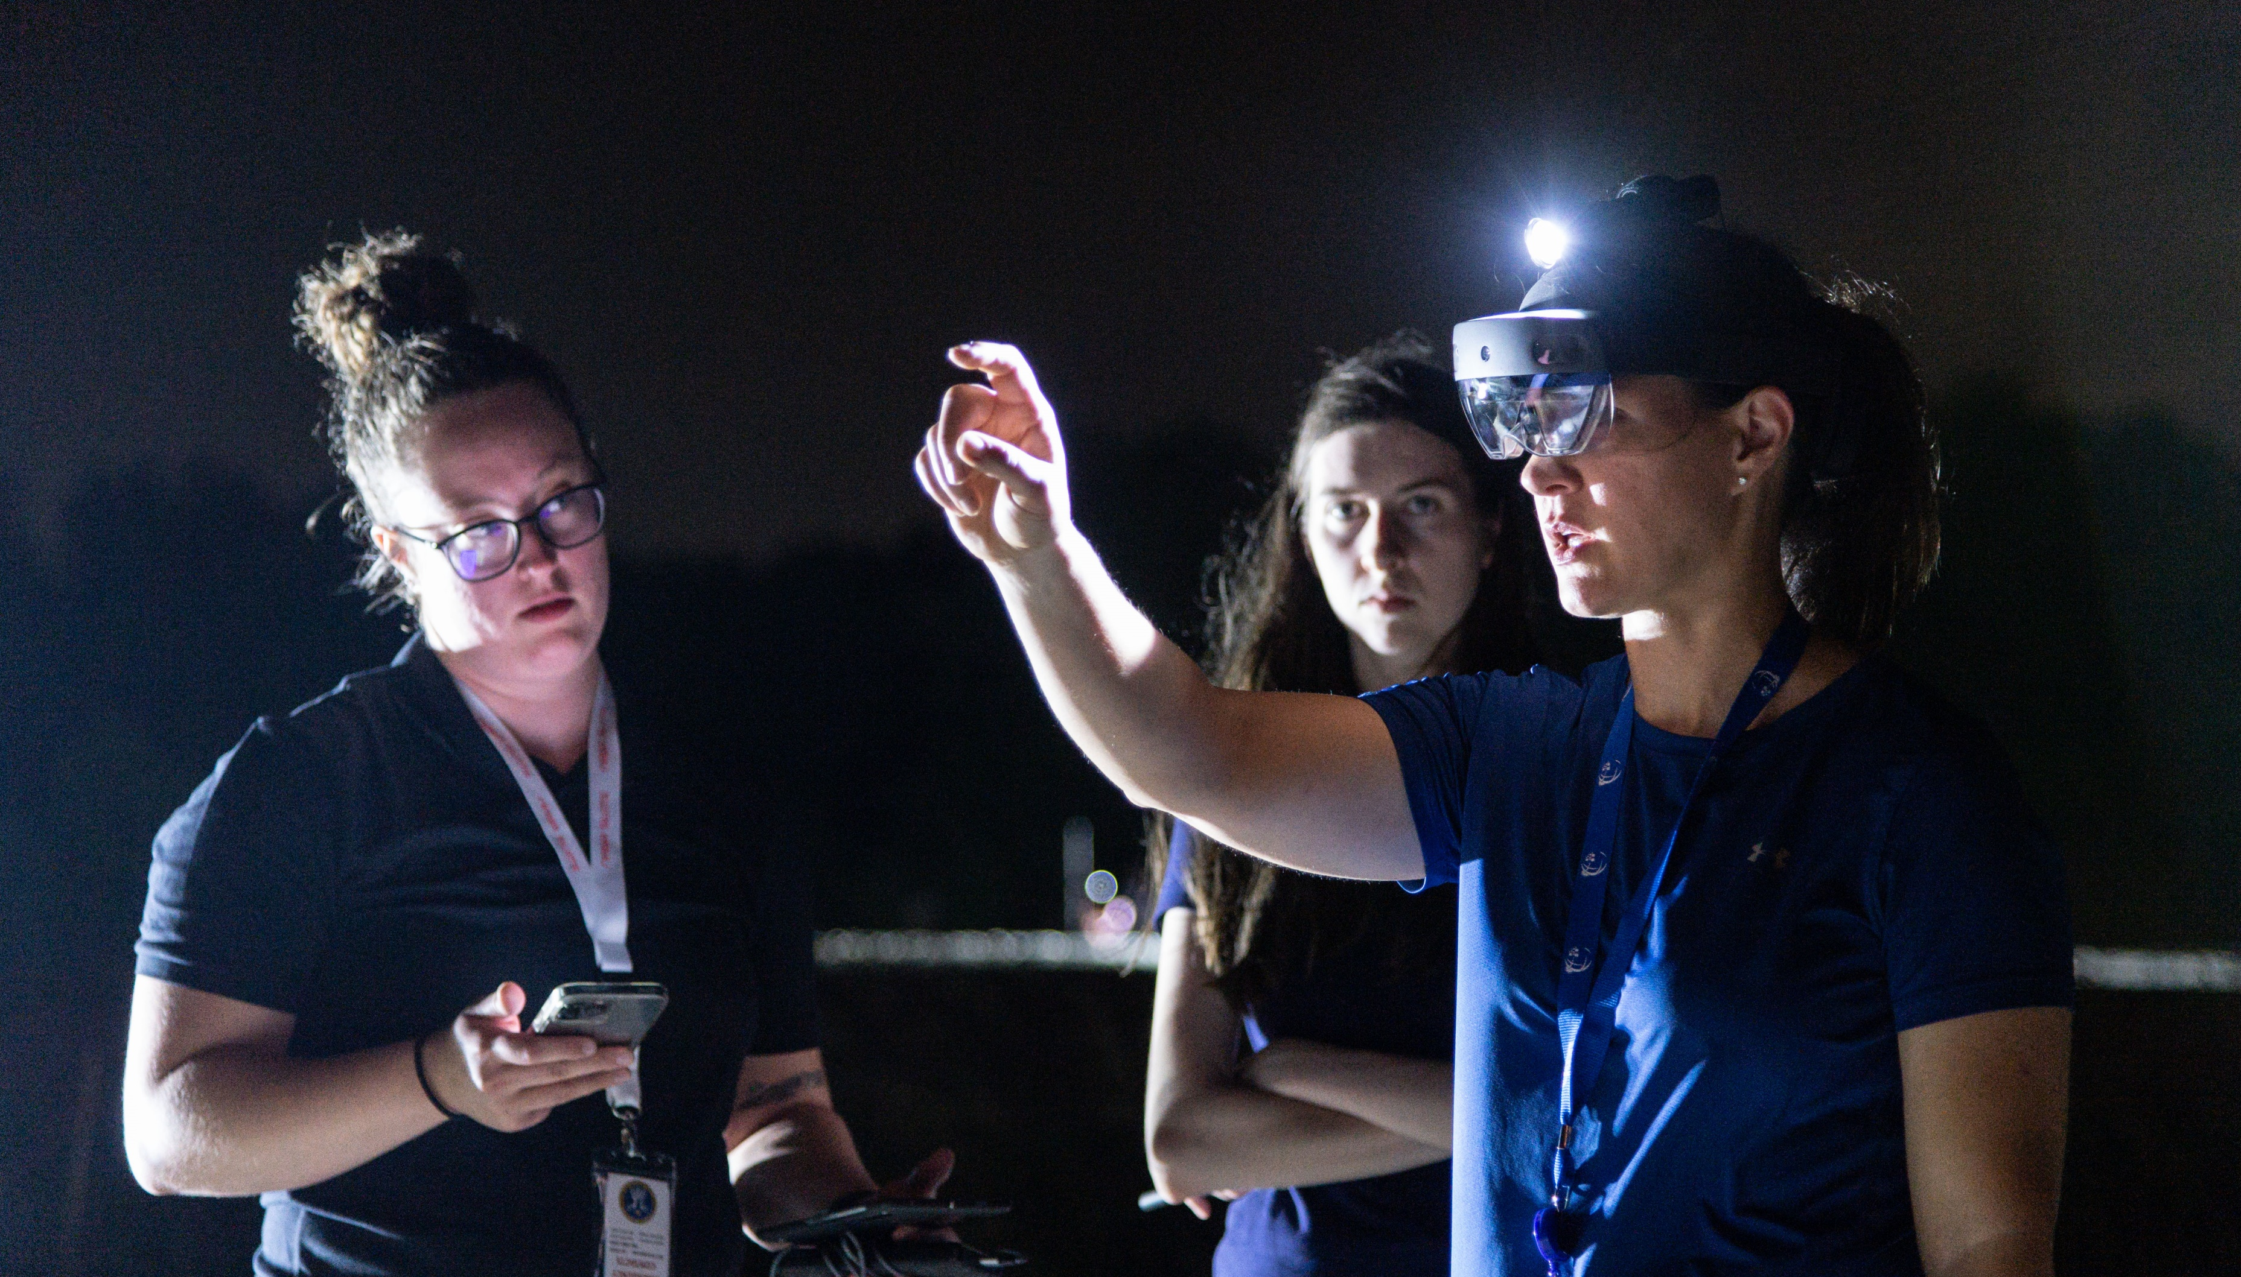
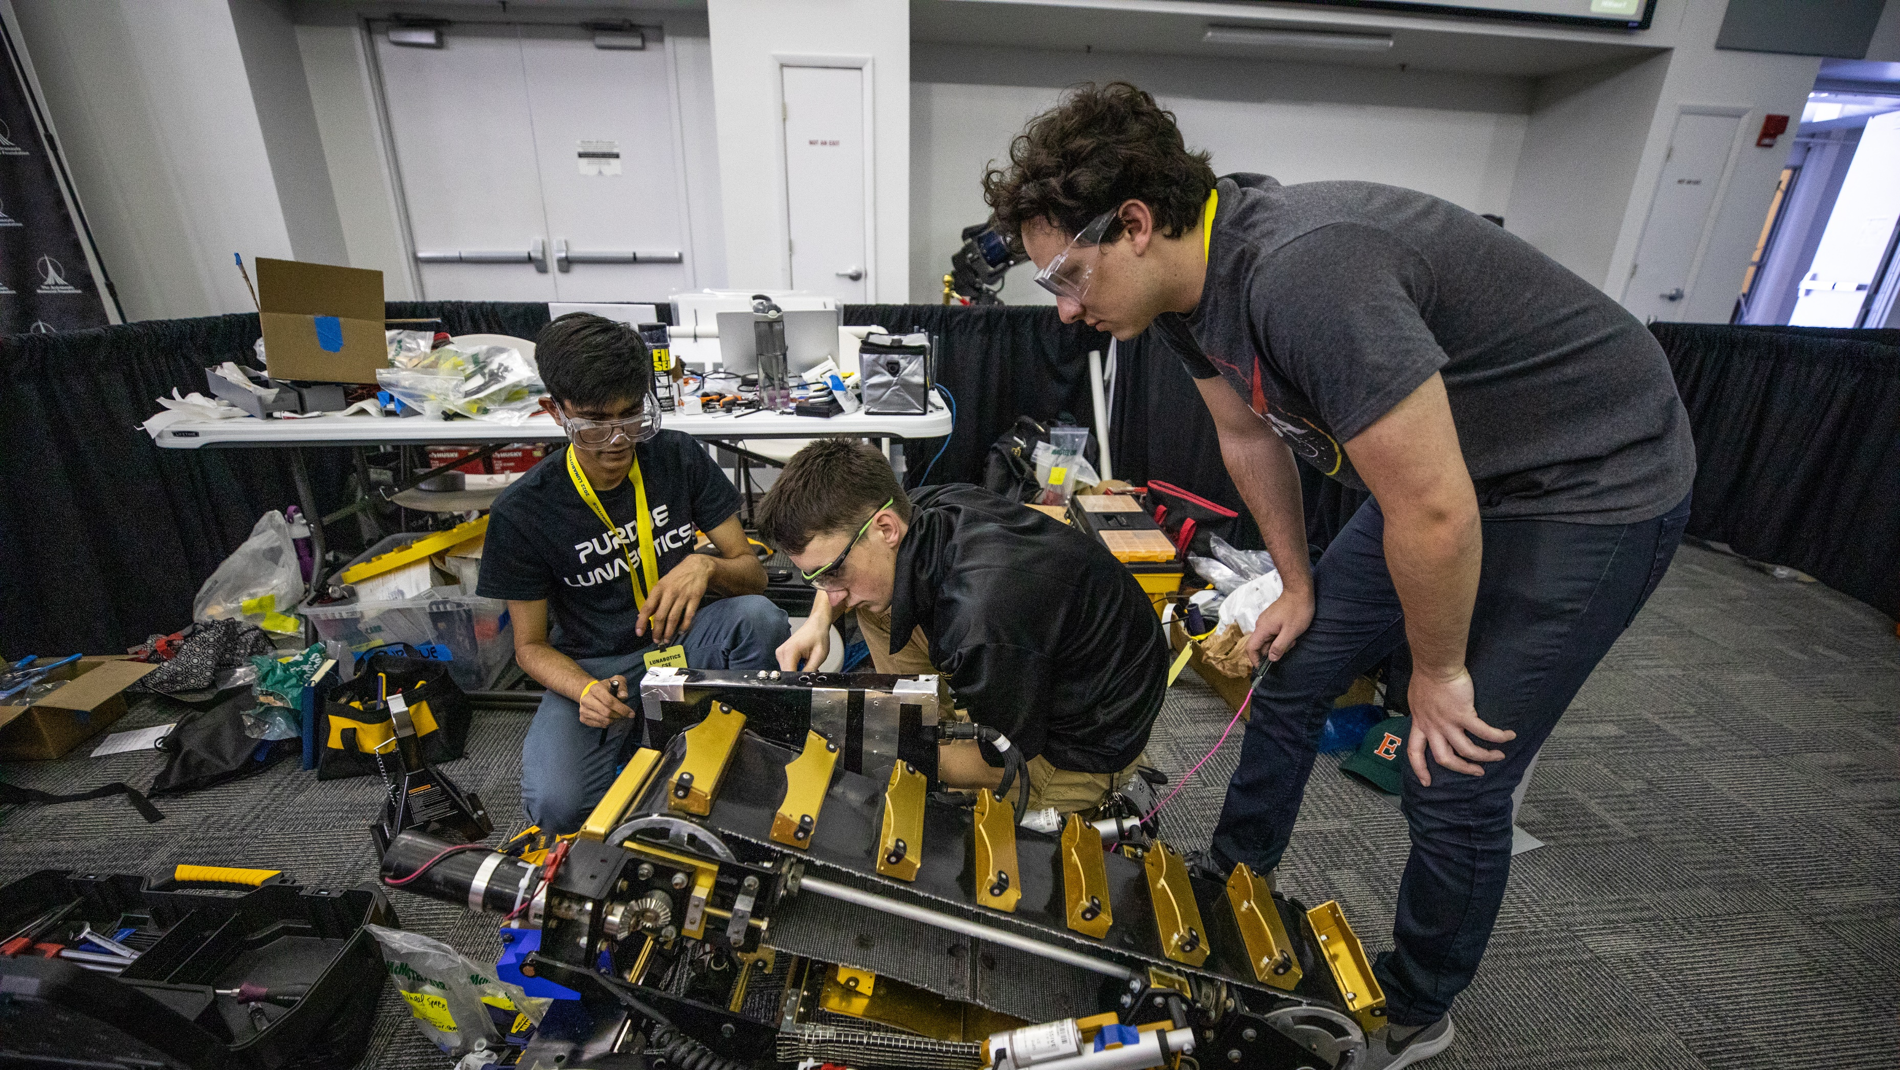
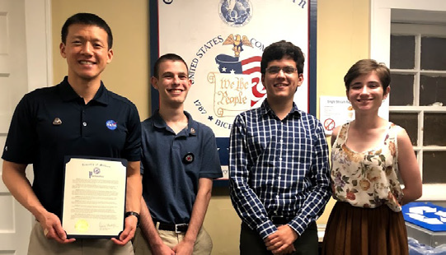
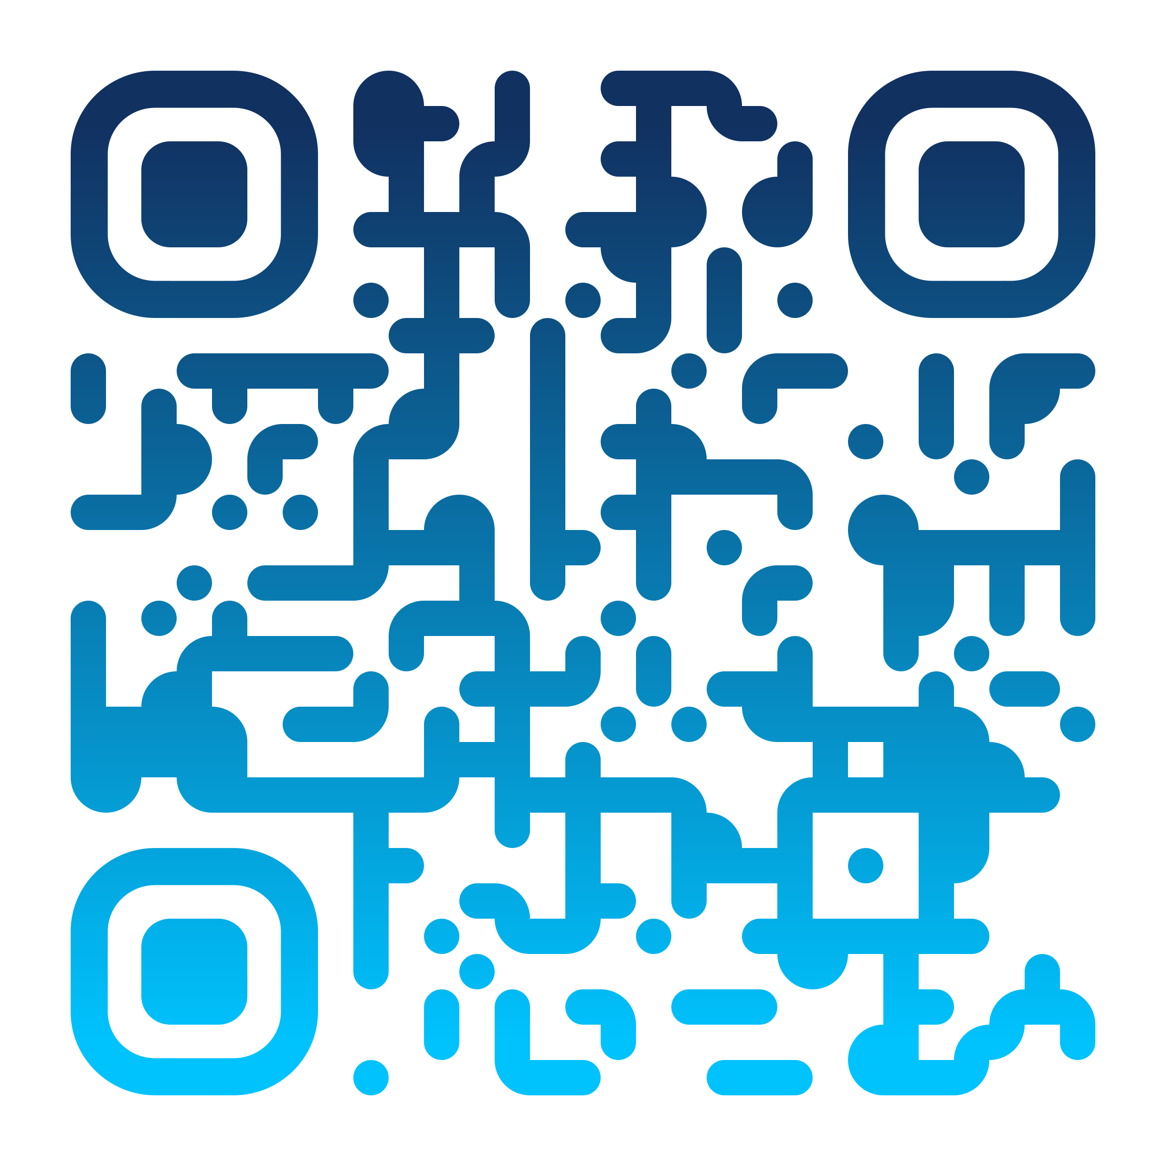
Student Launch
Colleges, universities,
high schools, and
middle schools
Research-based
Provides research and development of rocket propulsion systems
HERC - Human Exploration Rover Challenge
High school and college students worldwide
Create a vehicle designed to traverse the simulated surface of another world
Micro-g NExT - Neutral Buoyancy Experiment Design Teams
Undergraduate students
Design, build, and test
Addresses an authentic, space exploration challenge
First Nations Launch
Native American college students
Build and launch class K high-powered rockets
Workshops teach concepts necessary for a successful launch
ARTEMIS STUDENT CHALLENGES
NASA is committed to landing the first woman and first person of color on the Moon using innovative technologies to explore more of the lunar surface than ever before! Discover the Artemis Student Challenges and explore how you can take part in one of NASA’s mission-related challenges.
SUITS - Spacesuit
User Interface Technologies
for Students
Undergraduate and graduate teams
Design and create spacesuit information displays within an augmented reality environment
Lunabotics
University-level teams
Design, build, and run autonomously operated robot, traverse the simulated off-world terrain, and excavate the simulated lunar regolith
Big Idea Challenge
Student teams at Space Grant-affiliated colleges and universities
Support the Space Technology Mission Directorate’s work maturing high-impact technologies for a broad array of NASA missions
ADC - App Development Challenge
Middle and high school students
Coding-based challenge to solve technical problems provided by NASA as they relate to deep space exploration missions
To learn more about the Artemis Student Challenges visit stem.nasa.gov/artemis
Notes:
https://stem.nasa.gov/artemis/
https://www.nasa.gov/sites/default/files/atoms/files/asc_flyer.pdf

Slide 17
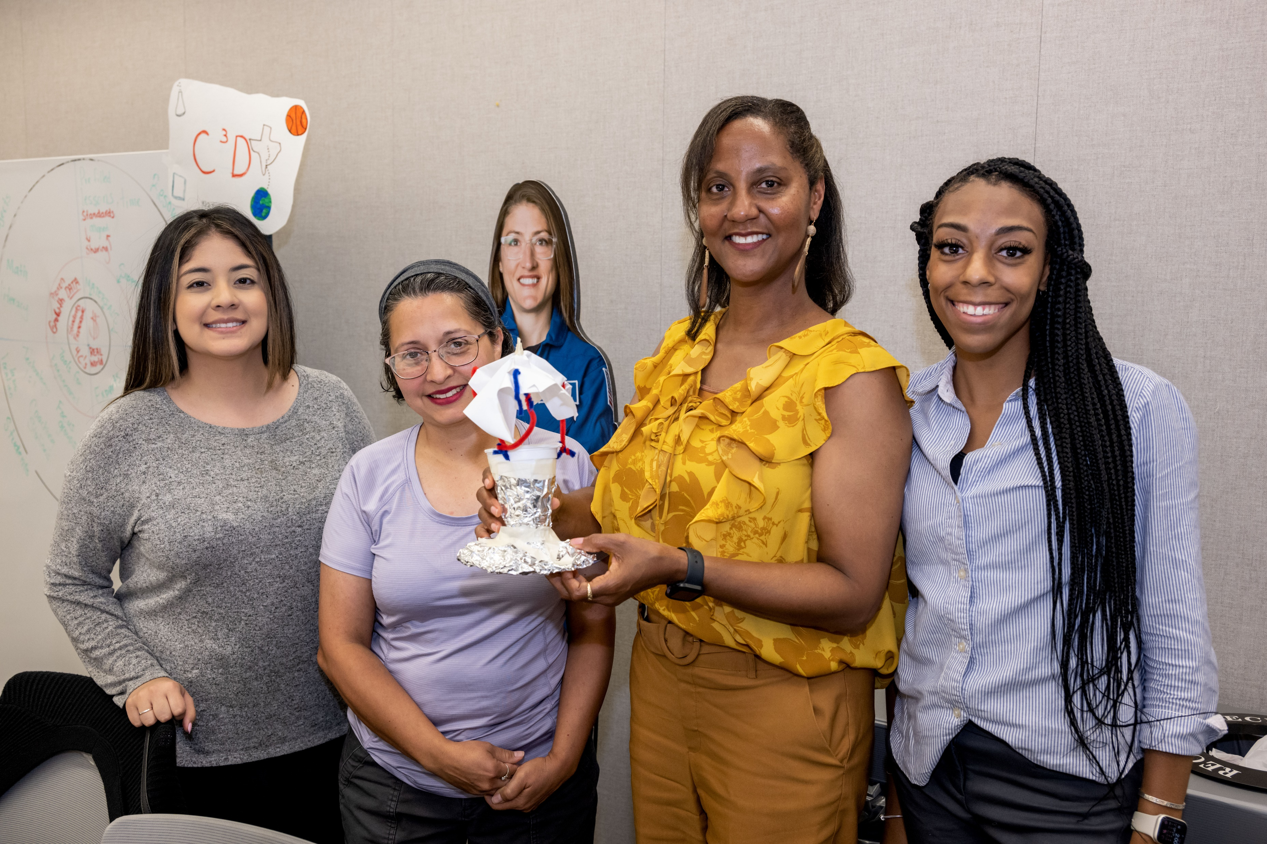
NASA Resources:
How to Stay Connected
Notes:
Script: Besides getting involved, you want you all to stay connected with us for future opportunities, engagements, and conversations as it related to your classrooms and institutions.

Slide 18
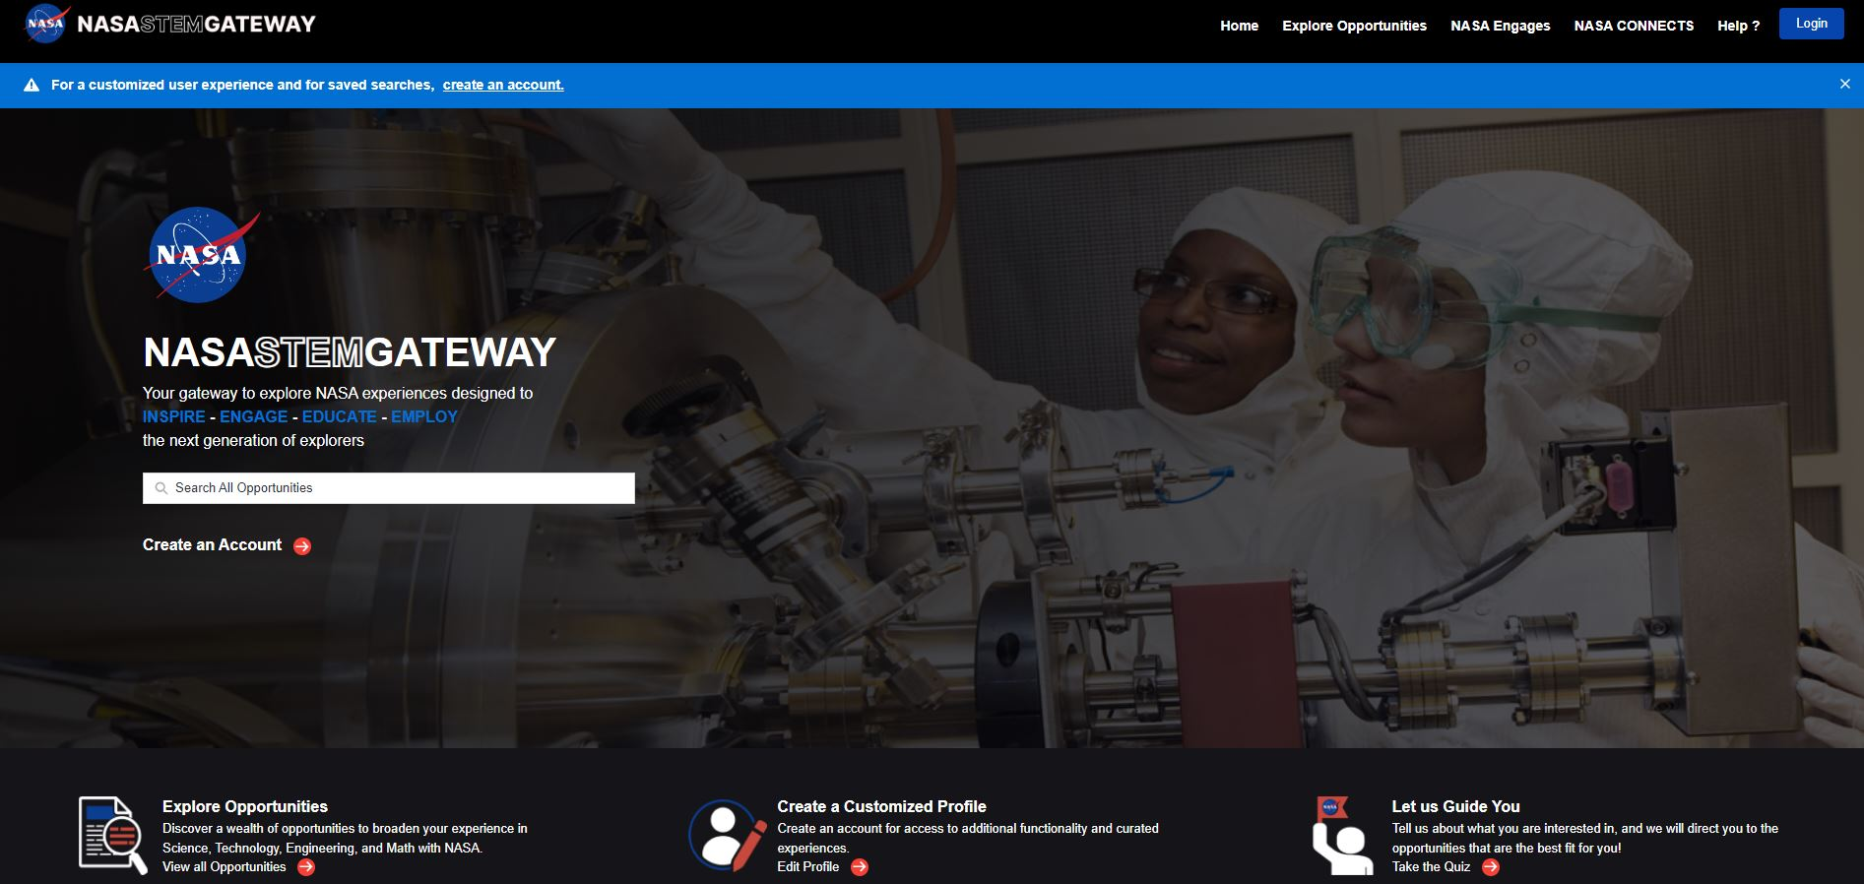
Notes:
Script: NASA STEM Gateway is the main platform to sign up for all NASA events and opportunities. NASA STEM Gateway is the gateway to explore STEM experiences designed to inspire, engage, educate, and employ the next generational of explorers. When you click to sign up for NASA CONNCECTS it will take you to sign up for Gateway first. Once you have this profile it is quick to register for CONNECTS and all other opportunities. This would be the same process for students if they were registering for events, internships, etc.

Slide 19

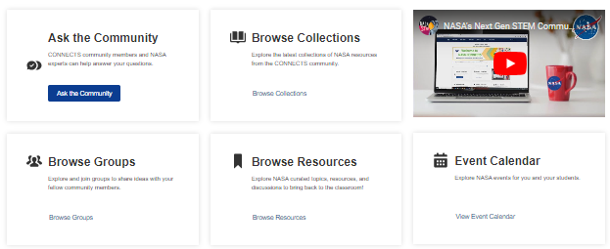

NASA CONNECTS
Registered community members will have the opportunity to sign up for engagement events, view and chat with other members who are interested in similar fields, read exclusive NextGen STEM content, and access resources such as lesson plans and interactive media.
Notes:
Updated as of 5/1/2024

Slide 20
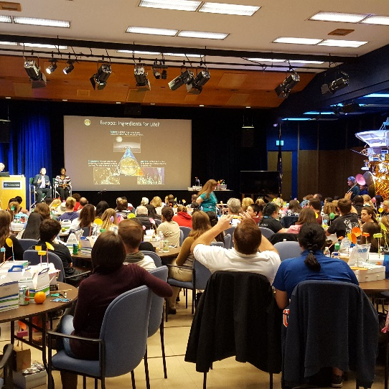
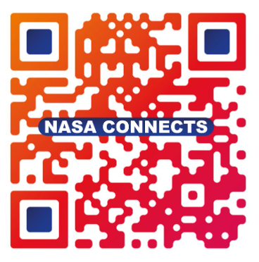
NASA CONNECTS Educator Community of Practice
NASA CONNECTS (Connecting Our NASA Network of Educators for Collaborating Together in STEM) is an online, professional learning community for educators to collaborate with each other and NASA.
Join Discussions & Connect With Others
Ask Questions
& Get Answers
Share & Discover New Best Practices
Download Free
STEM Products
Learn About Upcoming Events
See The Latest Opportunities
Museum & Informal Education Alliance
Scan to Join CONNECTS!
Notes:
Script: We want all educators to join us on NASA CONNECTS. CONNECTS stands for Connecting Our NASA Network of Educators for Collaborating Together in STEM. CONNECTs is our online professional learning community for educators to collaborate with each other and NASA. Join us in discussions, receive resources from our webinars, learn about upcoming events and more. The following slides will show you how to join CONNECTS step by step. You can follow along and register now, if you choose to, on your personal device or save as a task for after this training.
Stemgateway.nasa.gov/connects/
I think we should tell them about it and then explain we’re going to walk them through the process starting with Gateway registration
Here is another slide for you, I think this helps educators see the benefits more than maybe the flyer image.
CONNECTS – Connecting Our NASA Network of Educators for Collaborating Together in STEM
This is an online community of practice for informal and formal educators to access NASA STEM resources and collaborate with other educators.
Offers live virtual connections for CONNECTS educators and their students with NASA professionals and virtual coffee hours to talk about NASA STEM activities with NASA STEM team members and other educators.
Always shares the latest opportunities and NASA resources that are available.

Slide 21

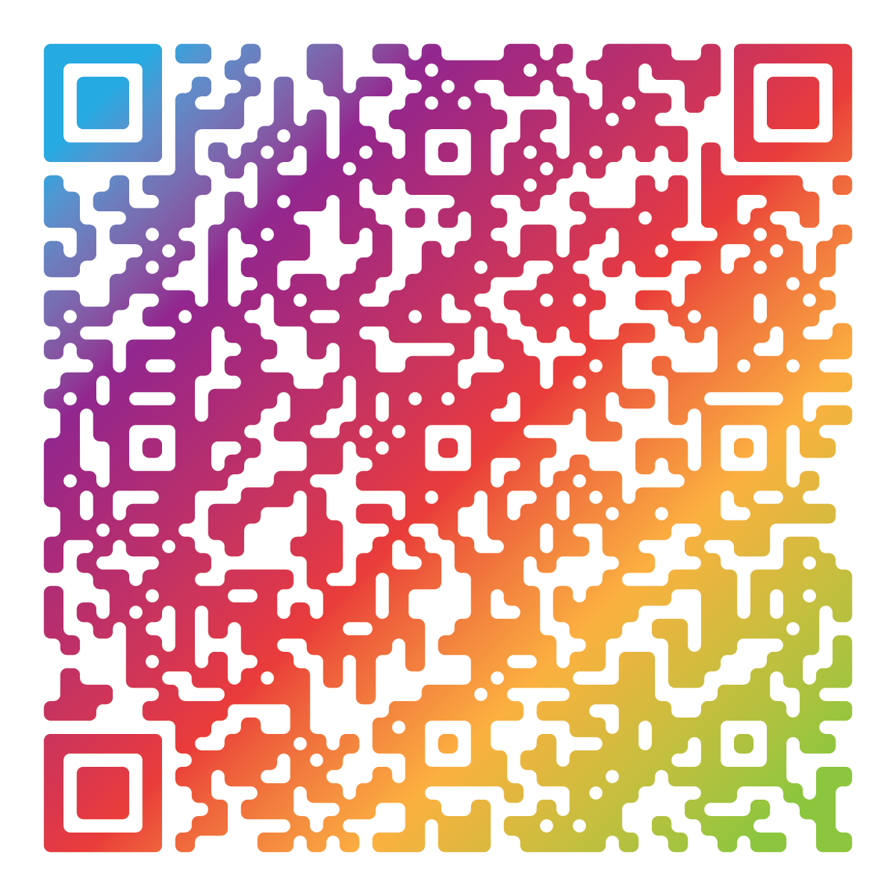
NASA 2024 Back-to-School Career Day
The Next Gen STEM project is hosting a virtual Career Day event on Thursday, September 26th (9:00 AM - 3:00 PM EDT).
Here's what awaits you:
Engage in live Q&A with NASA experts and get your questions answered!
Explore NASA virtually through interactive activities:
  Experience virtual tours of NASA facilities
  Engage in the NASA Recess Station
  Participate in classroom activities during live panels with NASA Subject Matter Experts
Scan here to register ➡️

Slide 22
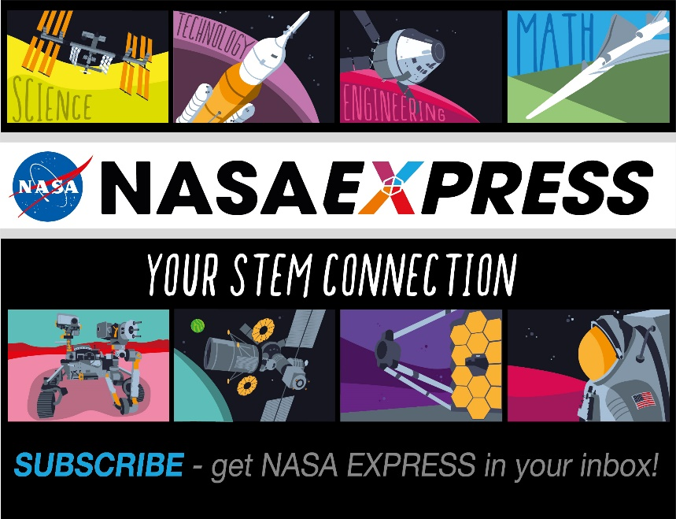
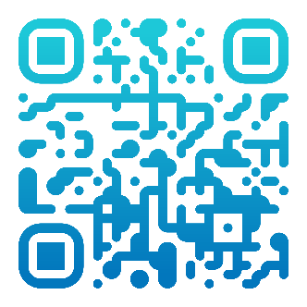
Subscribe to
NASA EXPRESS
nasa.gov/stem/express
Notes:
Script: In addition to NASA CONNECTS, please subscribe to NASA Express. NASA Express is NASA’s newsletter that gives the latest NASA resources for teachers, parents, caregivers, and students. It is an easy way to stay up to date on internships, challenges, cool facts, latest happenings and explorations, professional develop and more.
Subscribe to the NASA EXPRESS newsletter to get the latest NASA STEM opportunities delivered to your inbox every Thursday.
It’s an easy way to stay up-to-date on internships, challenges, professional development, and more. Learn about the latest NASA STEM resources and find ways to make STEM connections to NASA missions and milestones

Slide 23
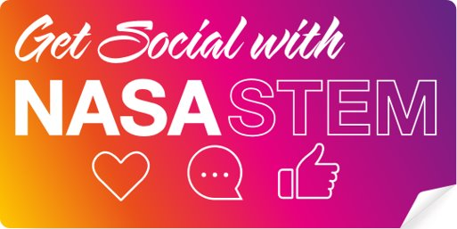




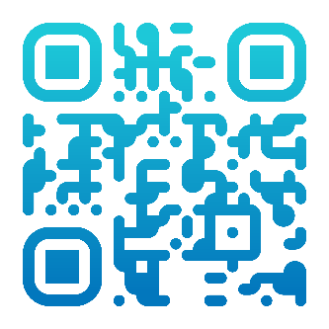
Connect with us on social media!
Follow NASA STEM on social media
@NASASTEM
pinterest.com/nasa/nasa-stem/
@NASASTEM
NASA STEM
Visit stem.nasa.gov
Notes:
Script: Lastly, If you’re interested in getting more involved and staying up to date on all the latest things at NASA, please connect it us on social media through our Twitter, Facebook, and YouTube channel.

